Slide 1
More Effective Posters
David E. Nelson
November 22, 2011
PBHL 507: Communicating Science to Lay Audiences

Slide 2
“In case you haven’t noticed, many posters these days are absolutely terrible, and they are getting worse each year.”
-Colin Purrington, Swarthmore College

Slide 3
Overview
Background
Major problems
Recommendations for improvement
Presenting a poster

Slide 4
Background
Posters are at the intersection of science and art
Visual medium
Not an oral presentation (e.g., PowerPoint) on a large sheet of paper
Not a manuscript on a large sheet of paper

Slide 5
Major Problems (I)
Not assessing the audience(s)
Insufficient preparation time
No clear objective (or hard to find); not focusing on a simple, clear message
Absence or inappropriate use of graphics

Slide 6
Major Problems (II)
Color choices: too many, use of red or green
Too much text and text too small
Including an abstract (there are exceptions)
Too many details about methods
Tables, tables, tables

Slide 7
Keys to an Effective Poster
Focused: Centered on a single message relevant to the intended audience(s)
Graphic: Allows graphs and images to convey messages with minimal text
Ordered: Arranged in a sequence to allow viewers to easily follow

Slide 8
Improving Posters (I)
Allow sufficient time to prepare and organize
Distinguish between audiences that are:
In your field
Fields related to yours
Unrelated fields
Relate & focus visuals/text to simple message

Slide 9
Improving Posters (II)
Use short declarative title with key finding(s)
Get feedback from others (including those not in your field) about draft layout
Dark colors on light backgrounds (black/white, yellow/blue); 2-3 max; not bright
Lots of white (open) space

Slide 10
Improving Posters (III)
Minimize text and make it readable:
-Short phrases (e.g., bullets) & no long paragraphs
-All text readable from 3-6 feet away (test: can text be easily read on 8x 11 inch version of the poster?)

Slide 11
Tips on Presenting a Poster (I)
Dress and act professionally: no hats, gum chewing, hands in pockets
Minimize or avoid perfume, hair or body spray
Bring poster hanging materials and arrive early

Slide 12
Tips on Presenting a Poster (II)
Stay by your poster during allotted time
Include your contact information on poster
Prepare and have handouts available

Slide 13
Tips on Presenting a Poster (III)
Don’t “hawk”
Prepare 1-sentence, 30 second, and 1-2 min presentation
Do not read your poster

Slide 14
Tips on Presenting a Poster (IV)
Cover these items:
-Context for problem (why it’s important [introduction])
-Objective and methods
-Results
-Implications of findings (discussion)

Slide 15
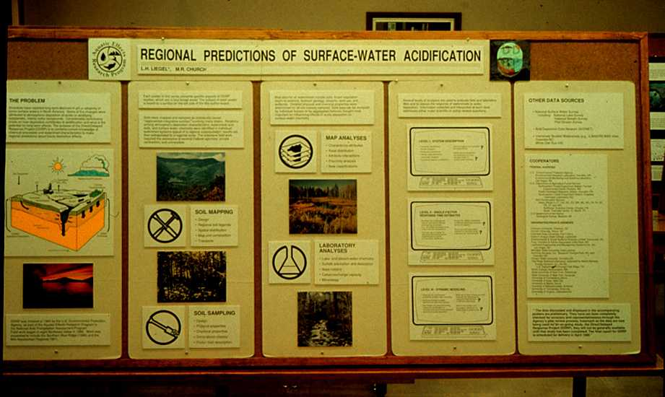

Slide 16
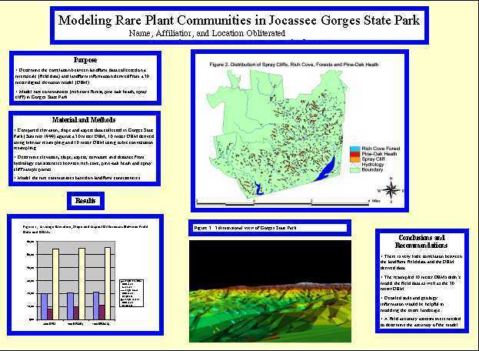

Slide 17
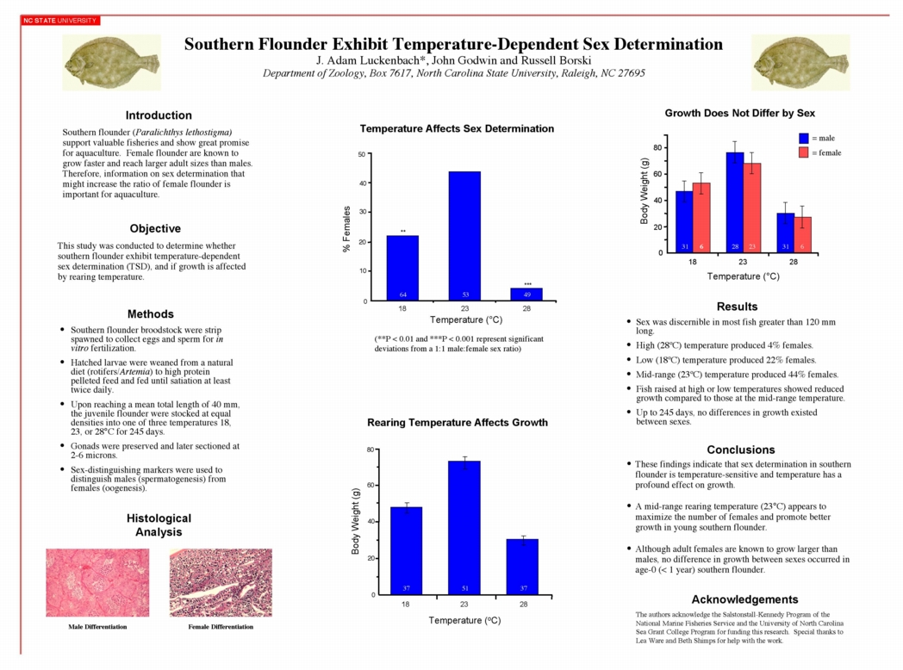
Deconstructing a Poster

Slide 18
Acknowledgments & Websites
Hess GR, Tosney K, Liegel L. Creating effective poster presentations; 2006. http://www.ncsu.edu/project/posters/NewSite/
(BEST RESOURCE!)
Purrington C. Advice on designing scientific posters. http://www.swarthmore.edu/NatSci/cpurrin1/posteradvice.htm

